Slide 1
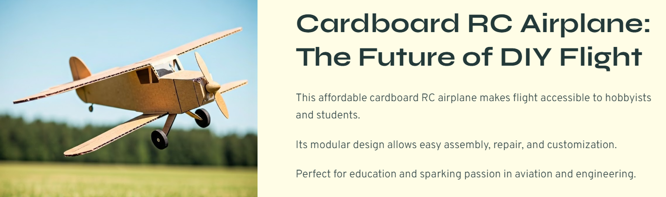

Slide 2
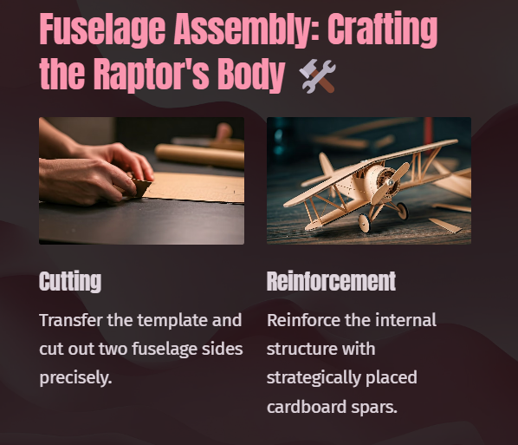

Slide 3
Materials Used in this project:
Electronics & RC Components:
Cardboard – Main body, wings, fuselage
Brushless Motor 2205 (2300 KV) – For propulsion
ESC (Electronic Speed Controller 20A FMS) – To control the motor
Propeller (5045) – For thrust
LiPo Battery (3S 1000mah battery 25C) b– Power source
Servos (9g x2) – To control rudder, elevator, ailerons
RC Transmitter & Receiver (TX+RX Microzone Mc6C) – For remote control
Servo Extension Wires / Y-cables – For connectivity
Battery Strap / Velcro – To secure the battery

Slide 4
(2)Optional Add-on Tools:
Landing Gear (light wire / foam wheels) – If landing/takeoff from ground.
Color Paper / Spray Paint / Markers – For design and visibility.
🛠️ Tips:
Keep it lightweight – weight is the enemy of flight.
Ensure good symmetry – imbalance can cause instability.
Test electronics on the ground before first flight.
Reinforce stress points (like motor mount and landing gear area).

Slide 5
Design and Construction:

Slide 6


